Slide 1

Objectives
In this session, you will learn to:
JavaScript HTML DOM Events

Slide 2
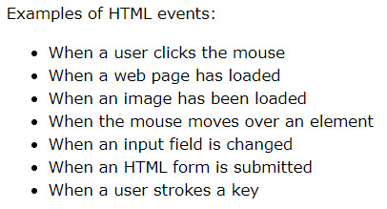
Reacting to Events
A JavaScript can be executed when an event occurs, like when a user clicks on an HTML element.
To execute code when a user clicks on an element, add JavaScript code to an HTML event attribute:
Example: onclick=JavaScript

Slide 3
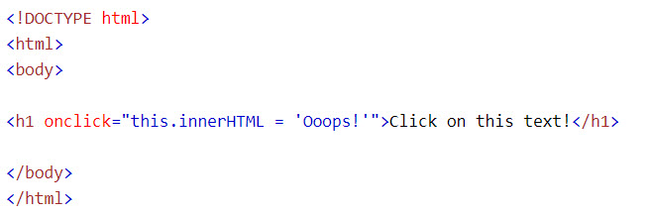
JS Events

Slide 4
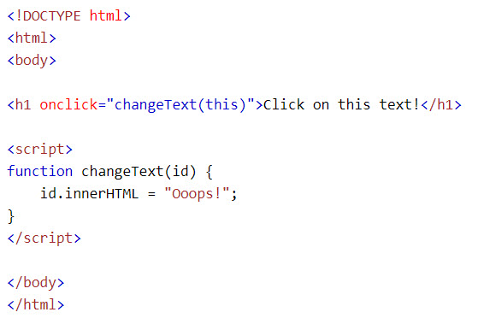

JS Events
We can associate an event with an event handler

Slide 5
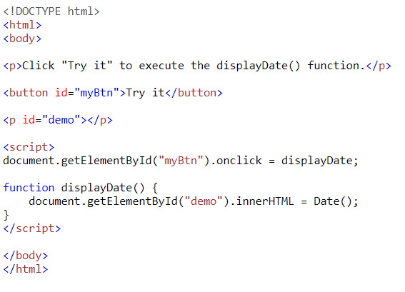
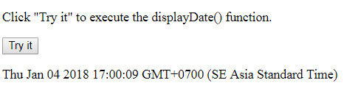
Assign Events Using the HTML DOM
The HTML DOM allows you to assign events to HTML elements using JavaScript:
Output:

Slide 6
List of events
The onload and onunload events are triggered when the user enters or leaves the page.
The onchange event is often used in combination with validation of input fields.
The onmouseover and onmouseout events can be used to trigger a function when the user mouses over, or out of, an HTML element.
The onfocus event: is triggered when user put focus into a control.
The onblur event: is triggered when user leave from a control.
The onresize event: is triggered when user resize a web page.
The onsubmit event: is triggered when user submit form.
The onmousedown, onmouseup, and onclick events are all parts of a mouse-click.
First when a mouse-button is clicked, the onmousedown event is triggered,
then, when the mouse-button is released, the onmouseup event is triggered,
finally, when the mouse-click is completed, the onclick event is triggered.

Slide 7
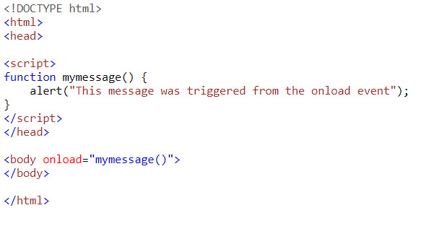
JS Events
Example of onload event:

Slide 8
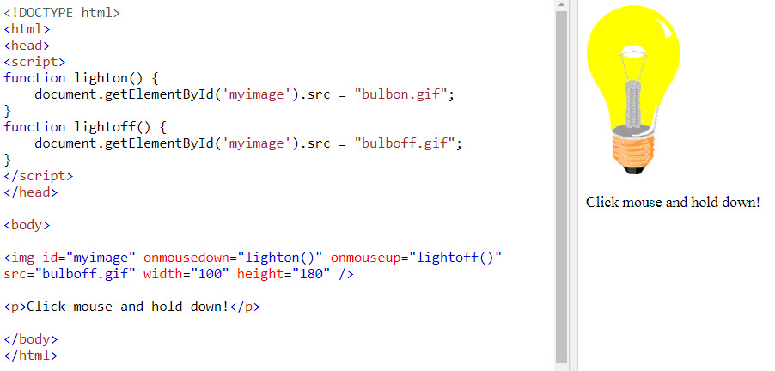
JS Events
Example of mouse events:

Slide 9
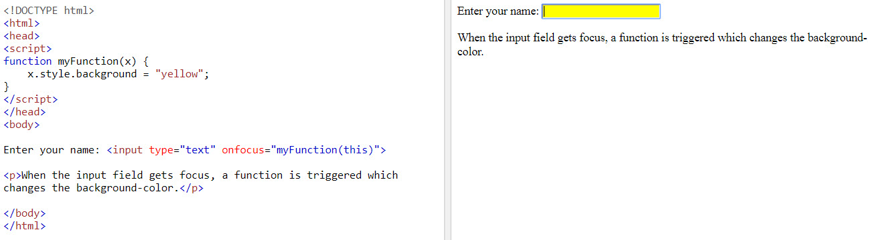
JS Events
Example of onfocus events:

Slide 10
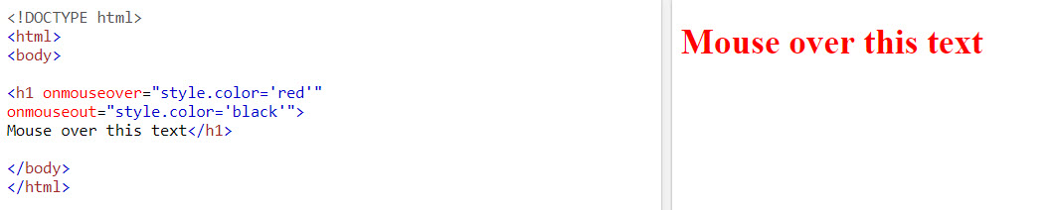
JS Events
Example of onmouseover/onmouseout events:

Slide 11
Summary
In this session, you learned that:
List of event in JavaScript
The meaning of each event

